Slide 1
Internet Service Types

Slide 2
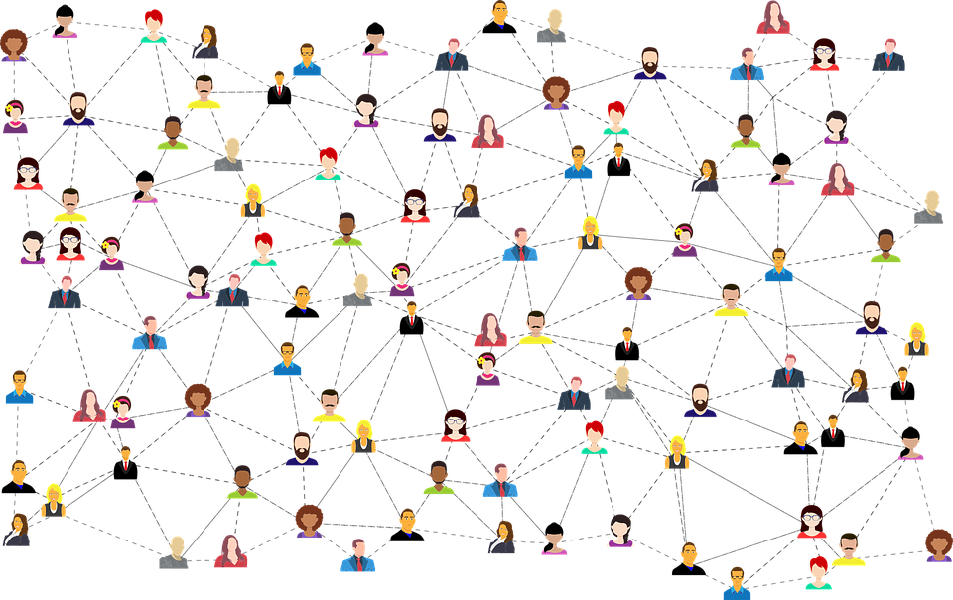
Service Considerations
Availability
Is it functional?
Throughput
Data transfer rates
Bandwidth
“Size” of connection

Slide 3

Connection Types
Fiber
Fastest
Lowest availability
Cable
Medium speed
Medium availability
DSL
Low speed
High availability
Wireless
Highly variable speed
Highest availability

Slide 4
Wireless Options
RF (Radio Frequency)
Certain wireless frequencies
Satellite
Connects with a satellite
Cellular
Connects via cell towers

